Slide 1
SQL Project
Music Store Analysis
-Ankit Gupta

Slide 2
Objective
● THE PROJECT AIMS TO ANALYZE A DIGITAL MUSIC STORE DATABASE USING SQL, PROVIDING STAKEHOLDERS WITH VALUABLE INSIGHTS FOR DECISION-MAKING.
● THROUGH SQL QUERIES, IT ADDRESSES QUESTIONS REGARDING GEOGRAPHICAL GROWTH, PURCHASE POWER, REVENUE, GENRE PERFORMANCE, AND MUSIC BAND POPULARITY.
● THE ANALYSIS OFFERS ACTIONABLE RECOMMENDATIONS TO DRIVE BUSINESS GROWTH AND OPTIMIZE PERFORMANCE.

Slide 3
Level Of Queries
EASY INCLUDES:
SELECT,GROUP BY,
ORDER BY,LIMIT, DESC/ASC
MODERATE INCLUDES:
JOINS,ORDER BY,
GROUP BY,LIMITS
ADVANCE INCLUDES:
CTE(COMMON TABLE EXPRESSION)

Slide 4
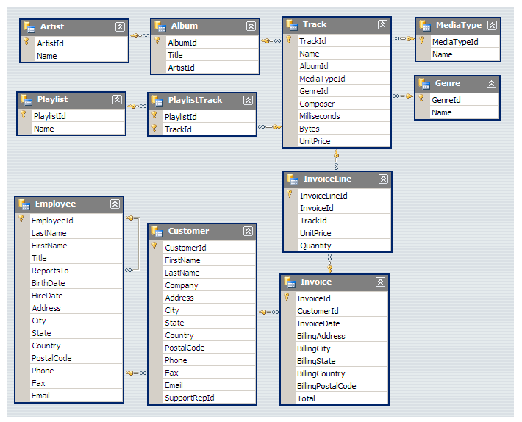
DATABASE SCHEMA

Slide 5
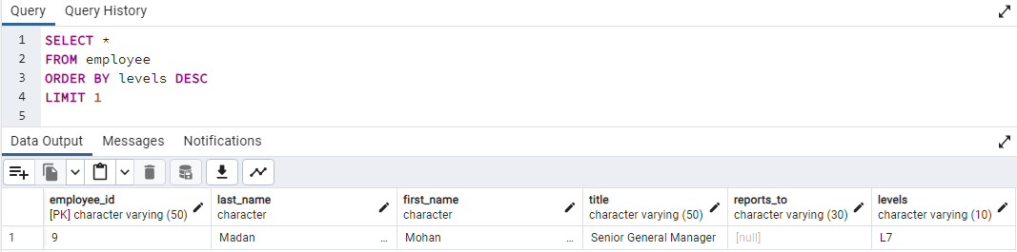
DATA INSIGHTS
1. Who is the senior most employee based on job title?
Solution-
SELECT *
FROM employee
ORDER BY levels DESC
LIMIT 1
Output-

Slide 6
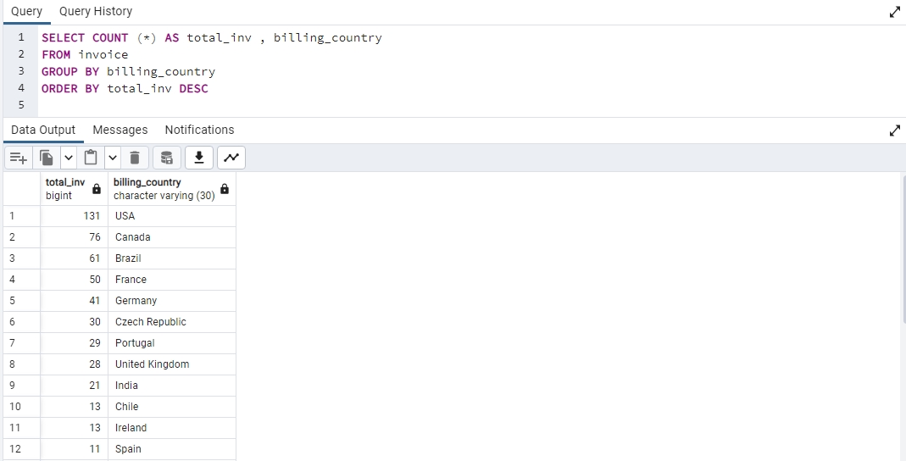
2. Which countries have the most Invoices?
Solution-
SELECT COUNT (*) AS total_inv , billing_country
FROM invoice
GROUP BY billing_country
ORDER BY total_inv DESC
Output-

Slide 7
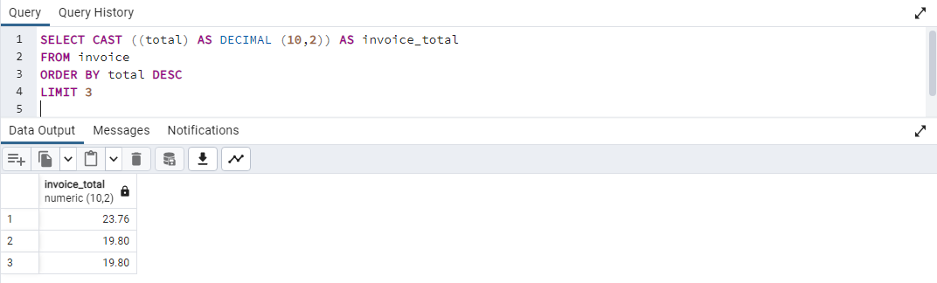
3. What are top 3 values of total invoice?
Solution-
SELECT CAST ((total) AS DECIMAL (10,2)) AS invoice_total
FROM invoice
ORDER BY total DESC
LIMIT 3
Output-

Slide 8
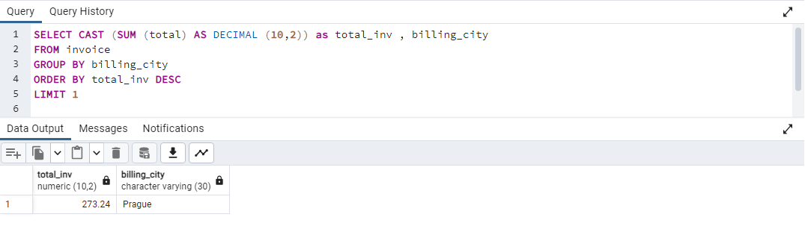
4. Which city has the best customers? We would like to throw a promotional Music Festival in the city we made the most money from. Write a query that returns one city that has the highest sum of invoice totals. Return both the city name & sum of all invoice totals.
Solution-
SELECT CAST (SUM (total) AS DECIMAL (10,2)) as total_inv , billing_city
FROM invoice
GROUP BY billing_city
ORDER BY total_inv DESC
LIMIT 1
Output-

Slide 9
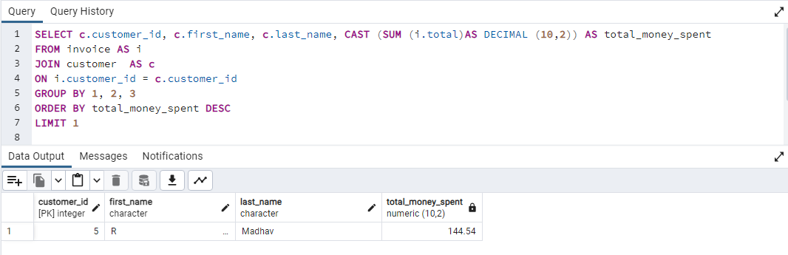
5. Who is the best customer? The customer who has spent the most money will be declared the best customer. Write a query that returns the person who has spent the most money.
SELECT c.customer_id, c.first_name, c.last_name, CAST (SUM (i.total)AS DECIMAL (10,2)) AS total_money_spent
FROM invoice AS i
JOIN customer AS c
ON i.customer_id = c.customer_id
GROUP BY 1, 2, 3
ORDER BY total_money_spent DESC
LIMIT 1
Solution-
Output-

Slide 10
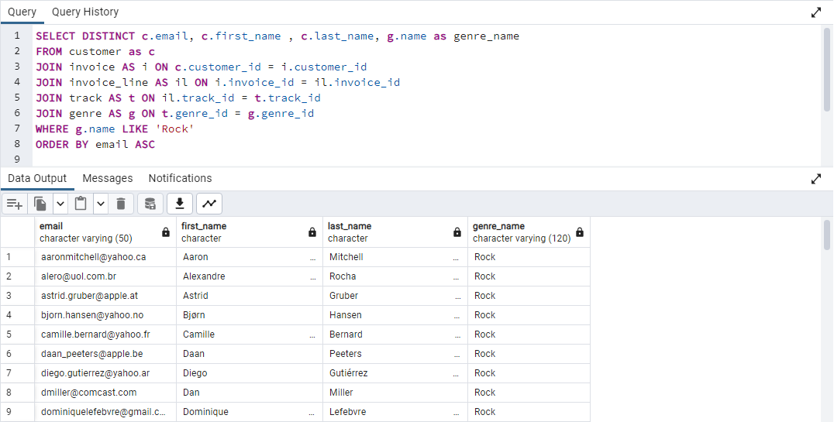
6. Write query to return the email, first name, last name, & Genre of all Rock Music listeners. Return your list ordered alphabetically by email starting with A.
Solution-
SELECT DISTINCT c.email, c.first_name , c.last_name, g.name as genre_name
FROM customer as c
JOIN invoice AS i ON c.customer_id = i.customer_id
JOIN invoice_line AS il ON i.invoice_id = il.invoice_id
JOIN track AS t ON il.track_id = t.track_id
JOIN genre AS g ON t.genre_id = g.genre_id
WHERE g.name LIKE 'Rock' ORDER BY email ASC
Output-

Slide 11
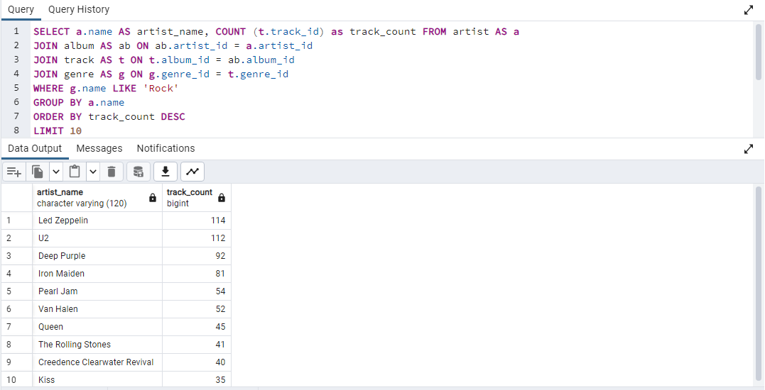
7. Let us invite the artists who have written the most rock music in our dataset. Write a
query that returns the Artist name and total track count of the top 10 rock bands
Solution-
SELECT a.name AS artist_name, COUNT (t.track_id) as track_count
FROM artist AS a
JOIN album AS ab ON ab.artist_id = a.artist_id
JOIN track AS t ON t.album_id = ab.album_id
JOIN genre AS g ON g.genre_id = t.genre_id
WHERE g.name LIKE 'Rock'
GROUP BY a.name
ORDER BY track_count DESC
LIMIT 10
Output-

Slide 12
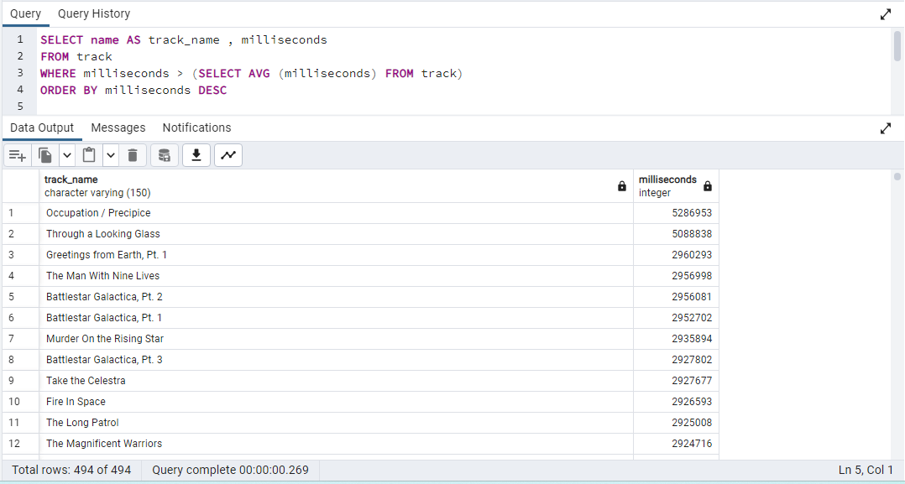
8. Return all the track names that have a song length longer than the average song length. Return the Name and Milliseconds for each track. Order by the song length with the longest songs listed first.
Solution-
SELECT name AS track_name , milliseconds
FROM track
WHERE milliseconds > (SELECT AVG (milliseconds) FROM track)
ORDER BY milliseconds DESC
Output-

Slide 13
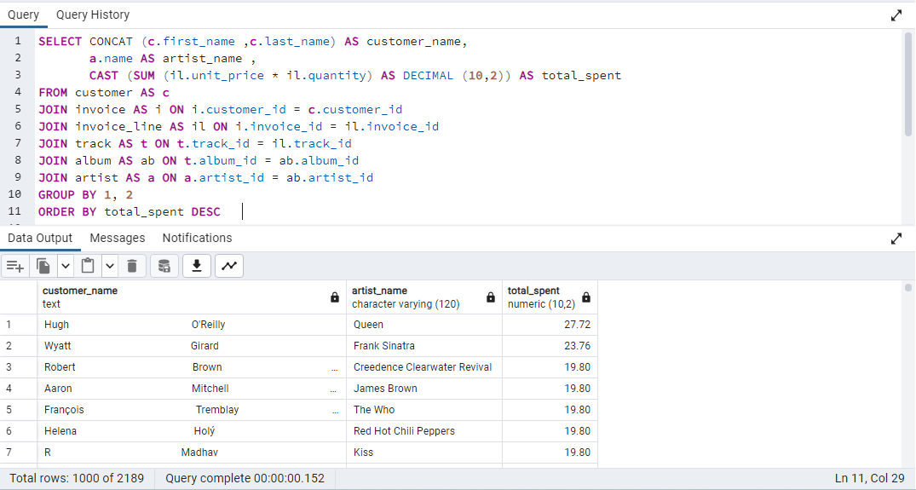
9. Find how much amount spent by each customer on artists? Write a query to return customer name, artist name and total spent
Solution-
SELECT CONCAT (c.first_name ,c.last_name) AS customer_name,
a.name AS artist_name ,
CAST (SUM (il.unit_price * il.quantity) AS DECIMAL (10,2)) AS total_spent
FROM customer AS c
JOIN invoice AS i ON i.customer_id = c.customer_id
JOIN invoice_line AS il ON i.invoice_id = il.invoice_id
JOIN track AS t ON t.track_id = il.track_id
JOIN album AS ab ON t.album_id = ab.album_id
JOIN artist AS a ON a.artist_id = ab.artist_id
GROUP BY 1, 2
ORDER BY total_spent DESC
Output-

Slide 14
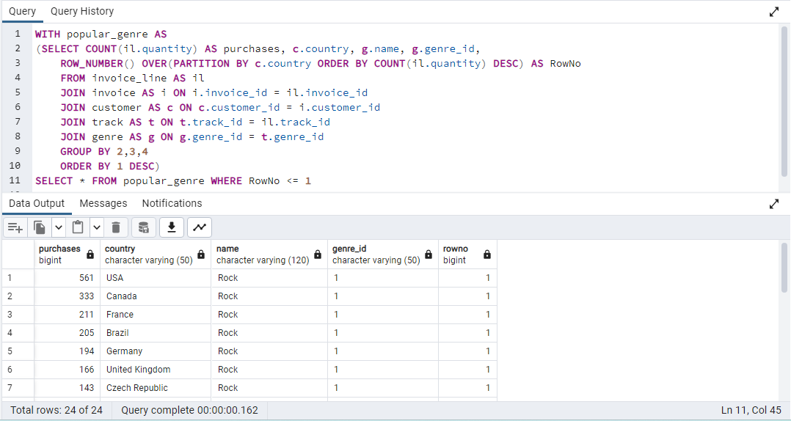
10. We want to find out the most popular music Genre for each country. We determine the most popular genre as the genre with the highest number of purchases. Write a query that returns each country along with the top Genre. For countries where the maximum number of purchases is shared return all Genres.
Solution-
WITH popular_genre AS
(SELECT COUNT(il.quantity) AS purchases, c.country, g.name, g.genre_id,
ROW_NUMBER() OVER(PARTITION BY c.country ORDER BY COUNT(il.quantity) DESC) AS RowNo
FROM invoice_line AS il
JOIN invoice AS i ON i.invoice_id = il.invoice_id
JOIN customer AS c ON c.customer_id = i.customer_id
JOIN track AS t ON t.track_id = il.track_id
JOIN genre AS g ON g.genre_id = t.genre_id
GROUP BY 2,3,4
ORDER BY 1 DESC)
SELECT * FROM popular_genre WHERE RowNo <= 1
Output-

Slide 15
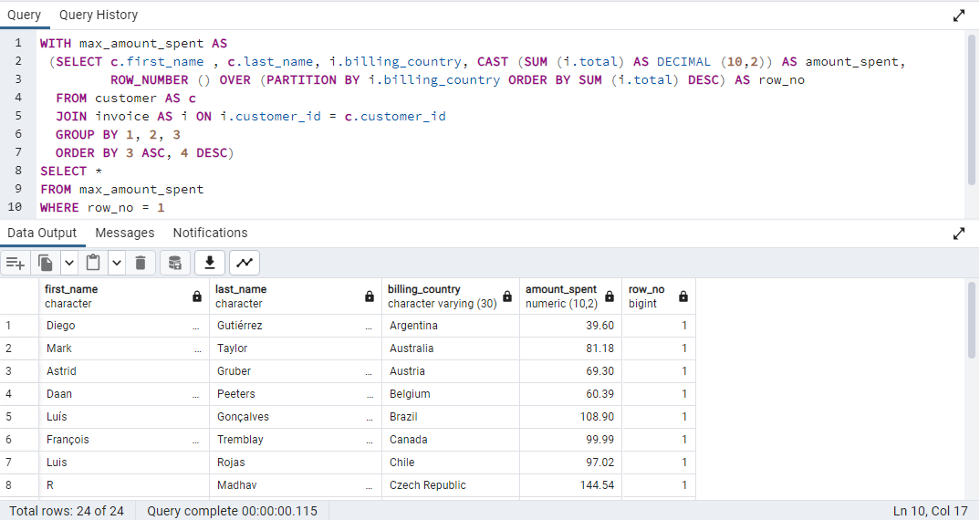
11. Write a query that determines the customer that has spent the most on music for each country. Write a query that returns the country along with the top customer and how much they spent for countries where the top amount spent is shared, provide all customers who spent this amount.
Solution-
WITH max_amount_spent AS
(SELECT c.first_name , c.last_name, i.billing_country, CAST (SUM (i.total) AS DECIMAL (10,2)) AS amount_spent,
ROW_NUMBER () OVER (PARTITION BY i.billing_country ORDER BY SUM (i.total) DESC) AS row_no
FROM customer AS c
JOIN invoice AS i ON i.customer_id = c.customer_id
GROUP BY 1, 2, 3
ORDER BY 3 ASC, 4 DESC)
SELECT *
FROM max_amount_spent
WHERE row_no = 1
Output-

Slide 16
Thank-You

